Slide 1

Year 1 – 2026
Phonics screening check

Slide 2
-To share why and how we teach phonics.
-To explain what the Phonics Screening Check is.
-To inform parents when the phonics check will take place and when you will receive feedback.
P
Phonics
Screening
Check
Year
1

Slide 3
-It’s part of the National Curriculum
During year 1, teachers should build on work from the early years foundation stage, making sure that pupils can sound and blend unfamiliar printed words quickly and accurately using the phonic knowledge and skills that they have already learnt. Teachers should also ensure that pupils continue to learn new grapheme-phoneme correspondences and revise and consolidate those learnt earlier. The understanding that the letter(s) on the page represent the sounds in spoken words should underpin pupils’ reading and spelling of all words.
P
Why do we teach phonics?

Slide 4
-Phonics develop your child’s ability to read and write.
P
Why do we teach phonics?
Being able to read is vital as your child continues their learning journey. Being a fluent reader means children can access many areas of the curriculum and supports writing skills and development.

Slide 5
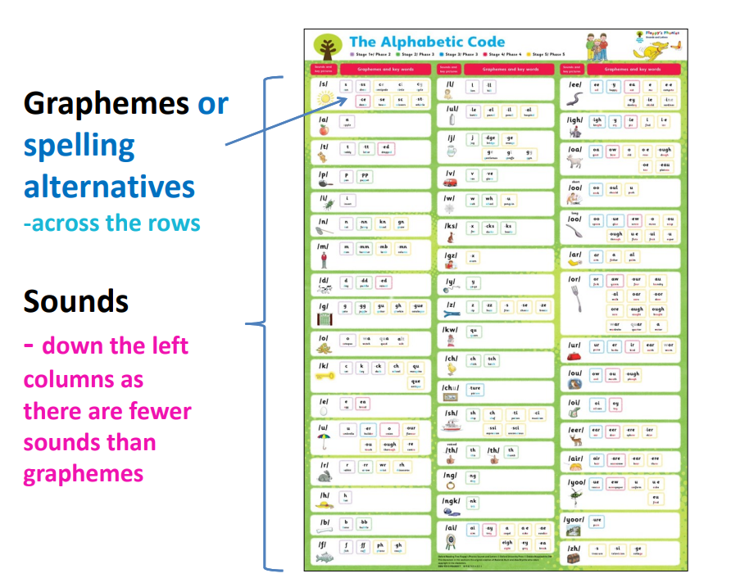
P
The
Alphabetic
Code

Slide 6
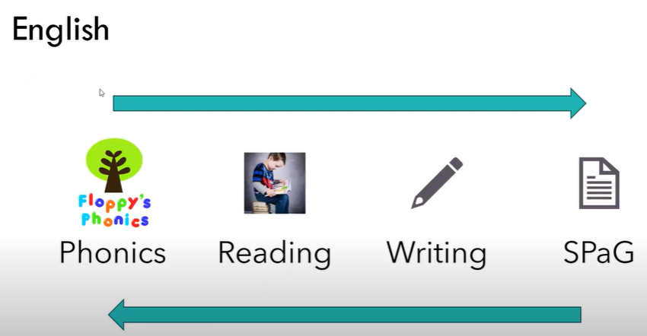
Why do we teach phonics?

Slide 7
The Phonics Screening Check (PSC)
The phonics screening check is designed to confirm whether pupils have learnt phonic decoding to an appropriate standard. It will identify pupils who need extra help to improve their decoding skills. The check consists of 20 real words and 20 pseudo-words that pupils read aloud.
When will the check be completed?
Monday 8th June – Friday 12th June

Slide 8
When will I get feedback about my child’s check?
You will receive the score that your child achieved with their end of year school report. The “standard” mark has historically been 32 out of 40.
What if my child doesn’t meet the standard?
You will have been informed at parents evening how your child is performing towards the check. If they don’t reach the standard they will have further added phonics intervention in Year 2. They will re-take the check in June of Year 2 and most children will pass at this point.

Slide 9
The phonics check paper is split into 2 sections.
Section 1 – less challenging - simple word structures –
20 words – 12 alien words and 8 real words
Section 2 – more challenging – more complex word structures –
20 words – 8 alien words and 12 real words
Why do we teach phonics?

Slide 10
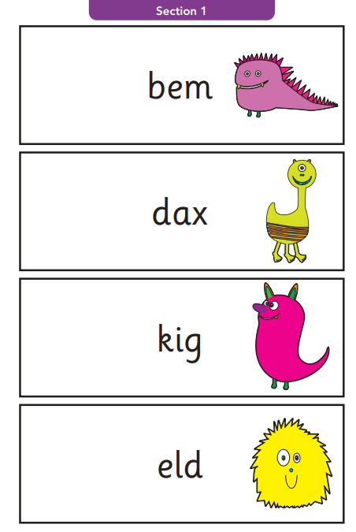
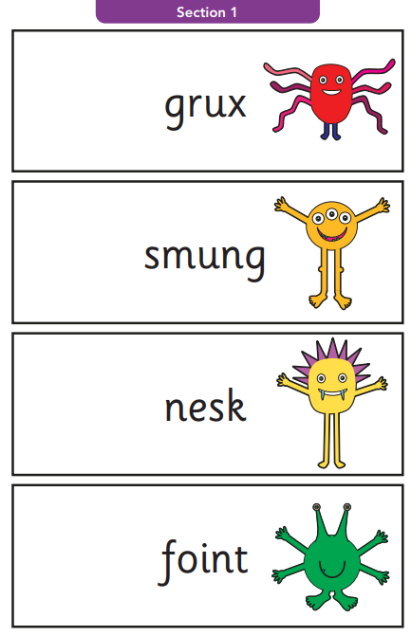
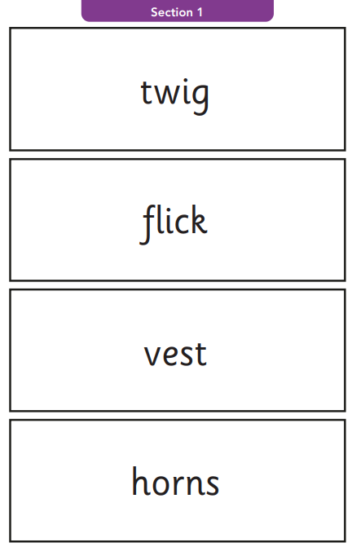
Why do we teach phonics?

Slide 11
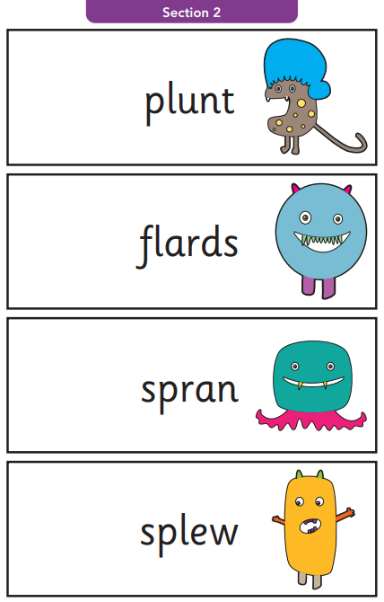
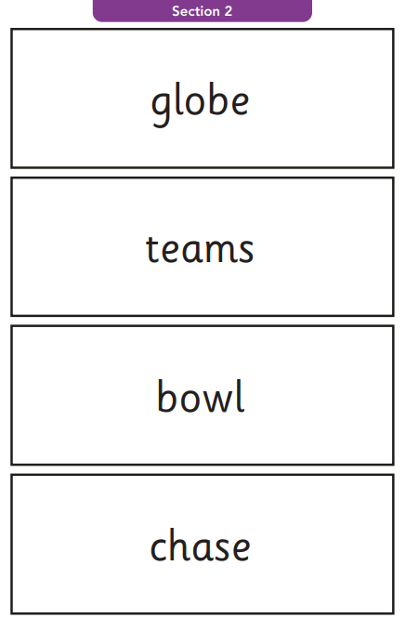
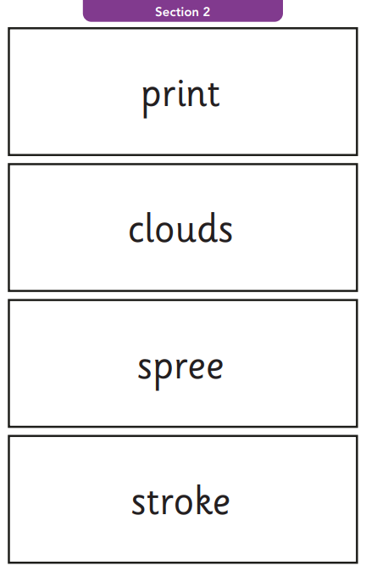
Why do we teach phonics?

Slide 12
Your child will have lots of opportunities to practise the PSC this half term.
The children enjoy taking the check, they sit 1:1 with their class teacher and are given plenty of support, encouragement and praise.
P
Phonics
Screening
Check

Slide 13
General ideas to support phonics
• Read every day with and to your child
• If your child is struggling to decode a word remind them ‘say each sound in the word from left to right.’ Blend the sounds by pointing to each phoneme, eg bright – b r igh t as you say the sound, then run your finger under the whole word as you say it.
• Talk about the meaning if your child does not understand the word they have read.
• Work at your child’s pace, stay positive and give lots of praise and encouragement.
Why do we teach phonics?

Slide 14
Make practice fun!
Here are some quick, fun games you can play at home using the focus phonemes in your child’s reading books. These will all help to increase confidence reading and blending sounds.
• Write down all the phonemes on separate pieces of paper and get your child to practise reading them quickly, one after the other. Mix up the order to make sure your child isn’t reciting them!
• Stick up different phonemes around a room and ask your child to hop to one phoneme, skip to one and jump to another as you call them out.
• Choose six diagraphs/trigraphs and give each one a number. Roll a dice and ask your child to say the phoneme that the dice lands on.
Why do we teach phonics?

Slide 15
Phonics support/revision at home
Ensure your child reads their school reading books – they are perfectly phonetically matched – exposing them to all the sounds learnt if they are ready OR focusing on certain sounds for consolidation.
Check Seesaw weekly for past phonics papers.
Use the free games on https://www.phonicsplay.co.uk/resources
Buried Treasure/Picnic on Pluto/Dragon’s Den – Give plenty of chance for children to practise applying their phonics skills. You can “Revise all Phase 5” or focus on individual sounds.
Why do we teach phonics?

Slide 16
P
Thankyou
Any questions?

